Slide 1
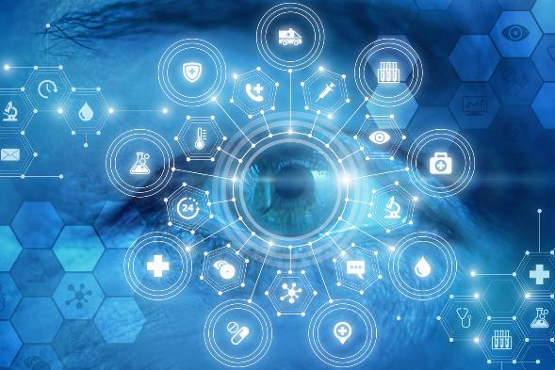
Real-World Data: How Sharing and Analysis Can Benefit You
Session 1
Understanding Real-World Data (RWD) and Registries

Slide 2
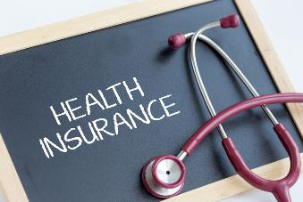
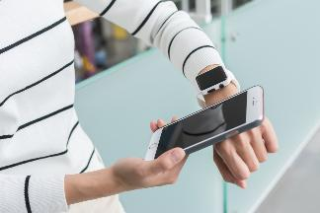
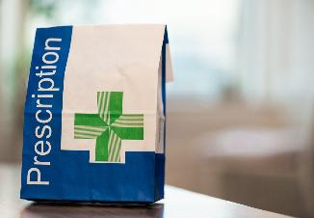
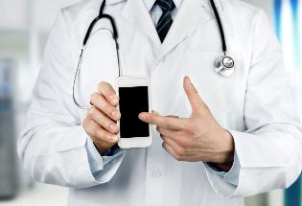

What is Real-World Data (RWD)?
  Definition: Real-World Data (RWD) is data from daily healthcare experiences, not just from scientific studies or clinical trials.
  Where it comes from: Information from doctor visits, hospital records, prescriptions, insurance claims, and even wearable devices like fitness trackers.
  Purpose: To understand patients’ real-life experiences, how treatments work in everyday life, and where improvements are needed.

Slide 3
Why is Real-World Data (RWD) important for You?
  Reflects, shows what Patients experience in their lives: RWD helps researchers and doctors, insurances and policy makers too, to understand what it’s like for real patients to live with a disease—not just during a study, but in everyday life. RWD is how your life goes … ☺
  Improves Treatments: Doctors can adjust treatments based on how patients like you respond to them in real-life settings, it is also helpful for patients to make the right decisions … more personalized medicine, better quality of life …
  Leads to better care: By studying this data, researchers can find gaps in care and develop better support programs for patients, now and in the future. It is a great learning process to find better ways for care.

Slide 4
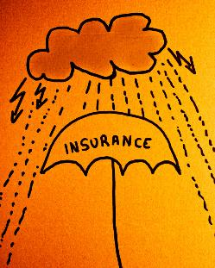
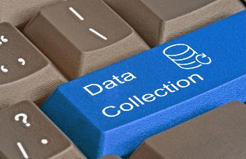
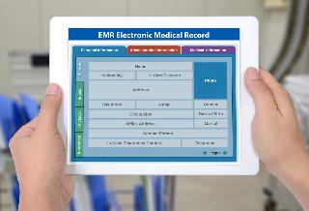
Sources of Real-World Data
  Electronic Health Records (EHRs): The doctor’s digital records, including the medical history, diagnoses, and treatment plans of a person (patient).
  Health Insurance Claims: Data collected by insurance companies when they reimburse medical treatments, showing costs, procedures, and medications.
  Patient Registries: Organized collections of information about people with specific diseases (e.g., cancer, multiple sclerosis) that help track treatment outcomes over time.

Slide 5


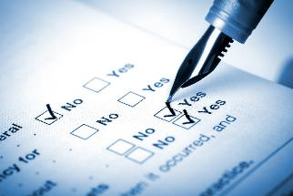
Sources of Real-World Data
Pharmacy Records: Information about the medications
a person has been prescribed.
Wearables & Apps: Fitness trackers or mobile apps that record a persons activity levels, sleep, heart rate, and other daily metrics.
        Please be aware that not all systems accept the data collected by Wearables / Apps, as this is not approved as medical devices. Also there is no standard of interoperability to connect data with systems.
Patient-Reported Outcomes (PROs):
Surveys where Patients share how they feel and how their treatment is
affecting their quality of life.

Slide 6

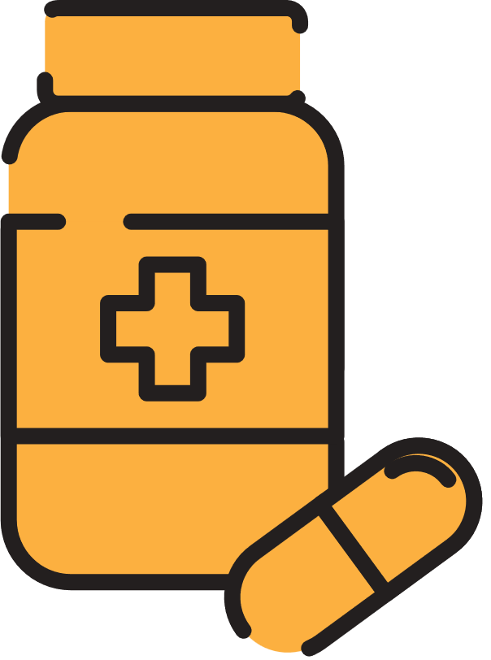
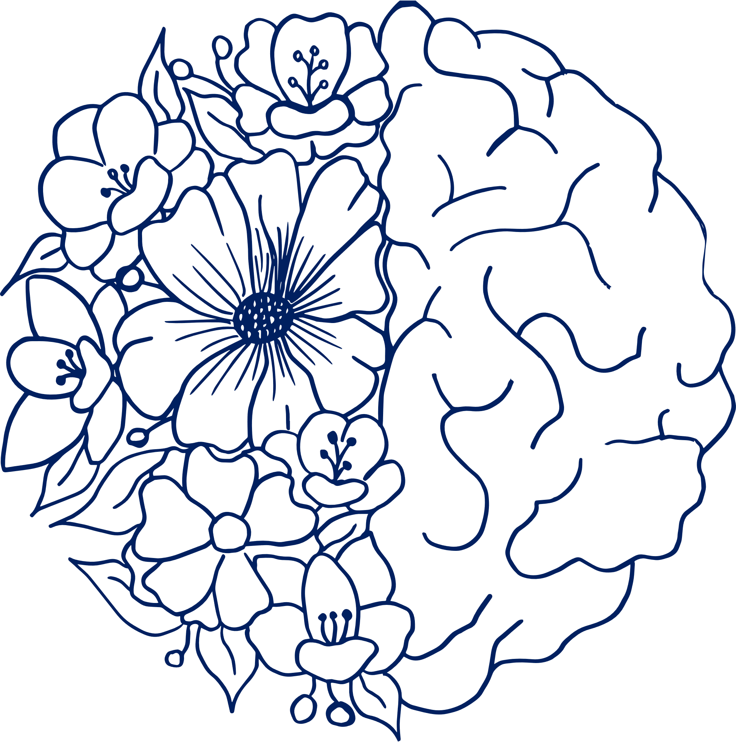
The power of your data
  Understanding Disease: RWD gives doctors a clearer view of how diseases affect patients in the real world.
        Improving Treatment: Patients data can show how effective treatments are in practice and where changes may be needed.
  Shaping the Future of Healthcare: By sharing experiences, Patients help doctors develop better treatments and support for future patients.

Slide 7

Challenges of Using Real-World Data
  Data Quality: Not all data is reliable. Some data from wearable devices may not meet medical standards.
  Different Types of Data: It’s hard to combine data from so many sources (e.g., doctor’s notes, insurance claims, apps) into a clear picture.
  Privacy & Security: Keeping your personal data safe is critical, and there are rules (like GDPR) to protect your health information.
  Please be aware: There is a difference in Privacy and Security:
  Privacy: Is to make sure, that your data are protected to keep your privacy.
  Security: Is to make sure, that data are stored safely. This is more technical.

Slide 8

What is Real-World Evidence (RWE)?
You might wonder—what’s the difference between Real-World Data and Real-World Evidence?
Real-World Data (RWD): The raw information that comes from everyday healthcare.
Real-World Evidence (RWE): What researchers get after analyzing RWD to make sense of it
Difference: Think of RWD as raw ingredients in cooking, and RWE as the final meal that helps doctors make decisions.
It’s like starting with ingredients for a meal (RWD) and ending with a delicious dish (RWE) that helps improve your care.

Slide 9

How RWD Becomes RWE
Step 1: Data Collection: Gathering RWD from sources like EHRs, apps, and insurance claims.
Step 2: Data Integration: Organizing and combining the data so it’s useful.
Step 3: Analysis: Researchers study the data to find patterns.
Step 4: Application: Insights from the analysis are used to improve medical care.
Step 5: Continuous Learning: The more data we gather and analyze, the more healthcare improves.

Slide 10
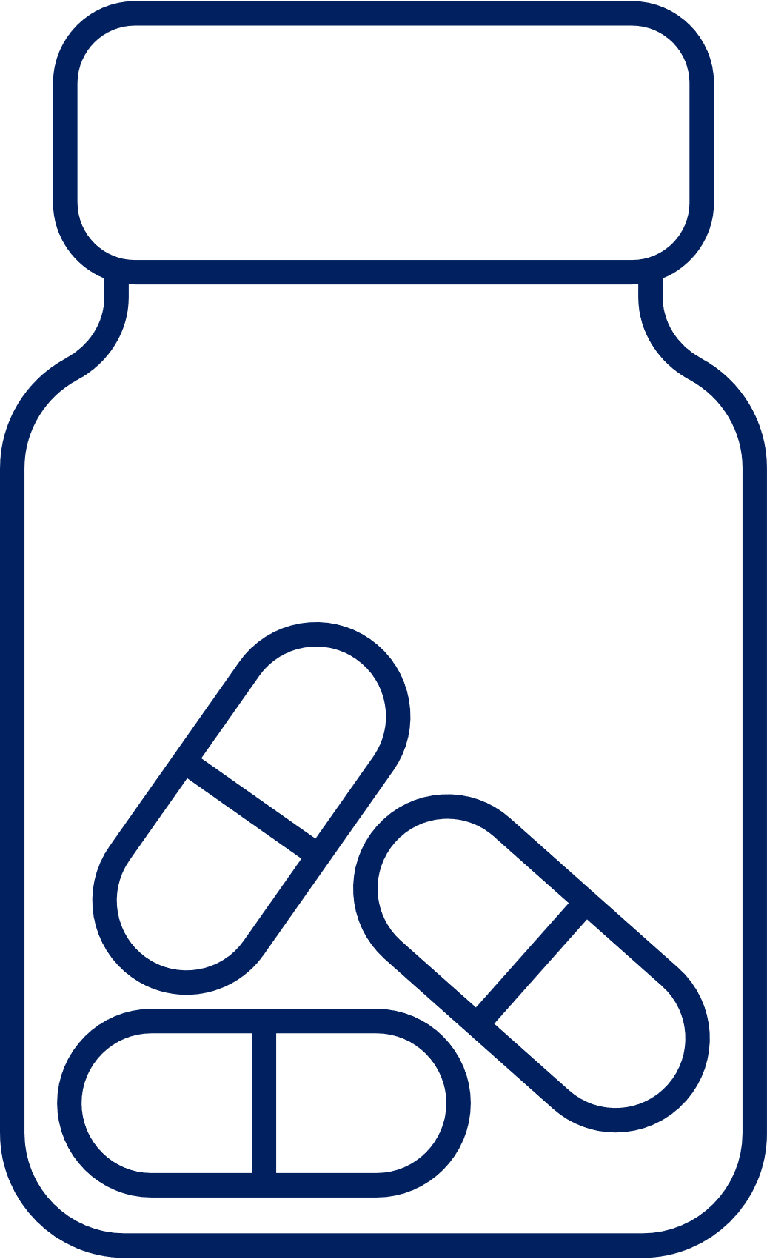
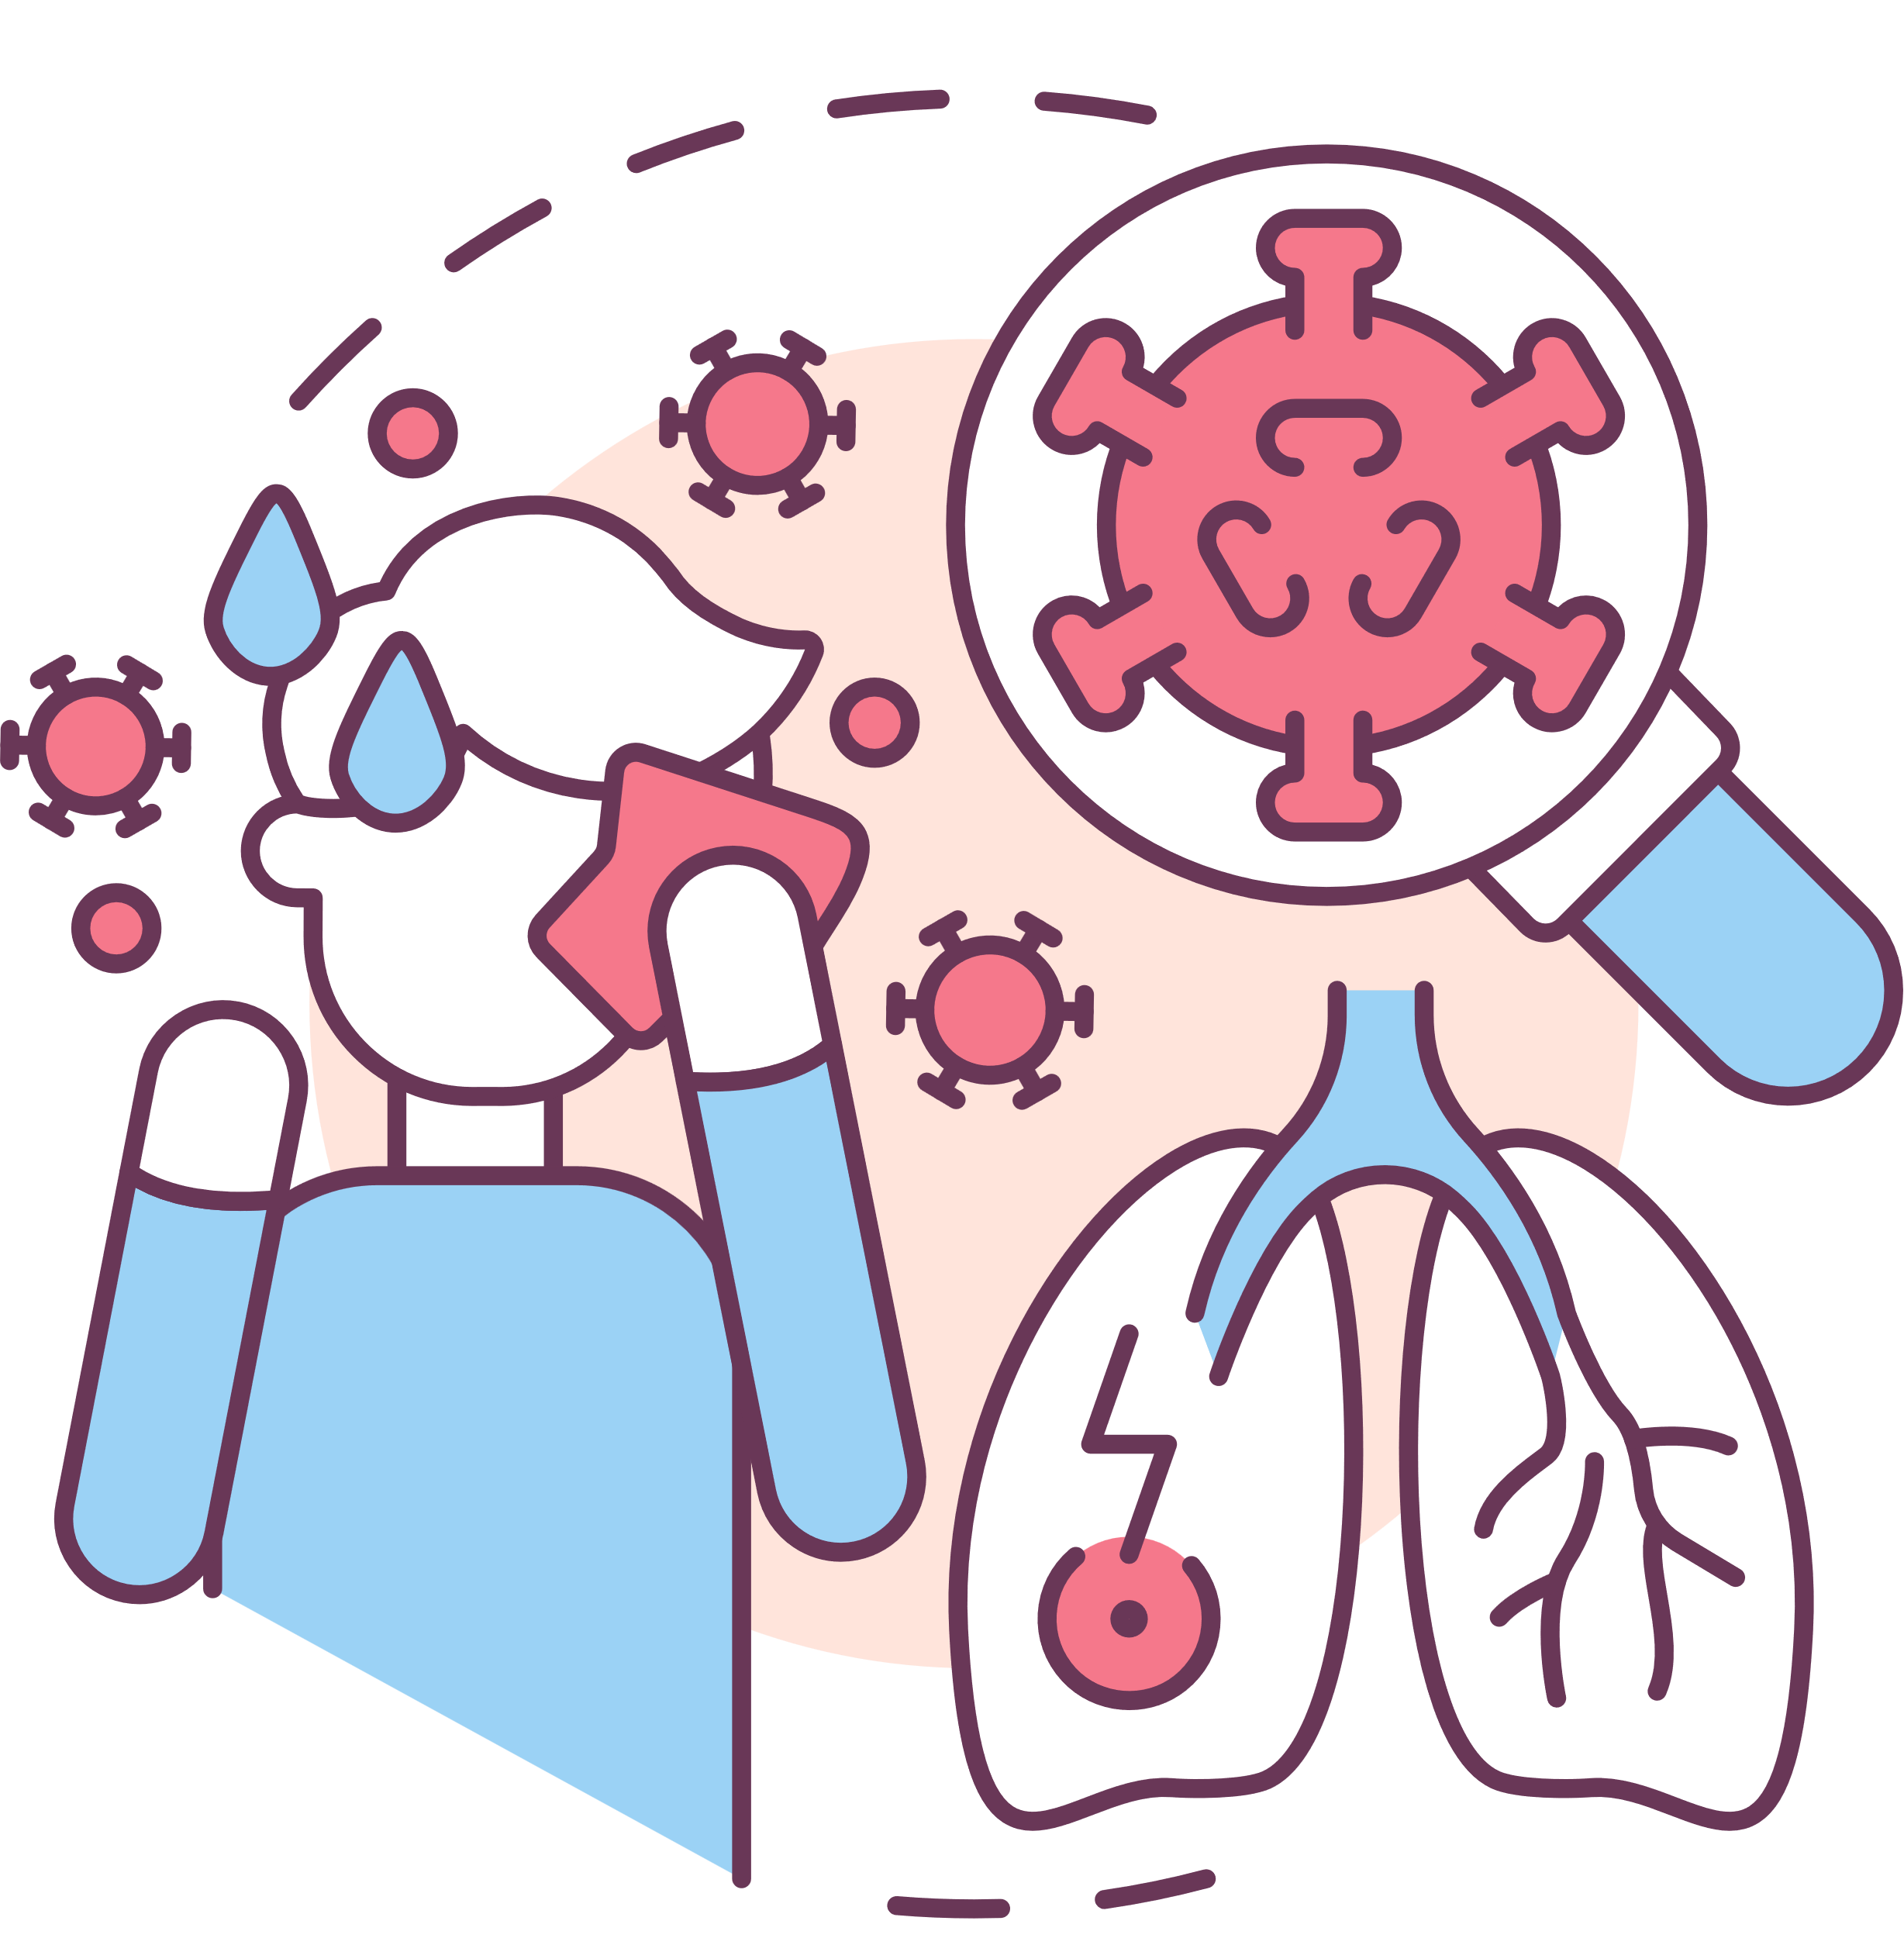
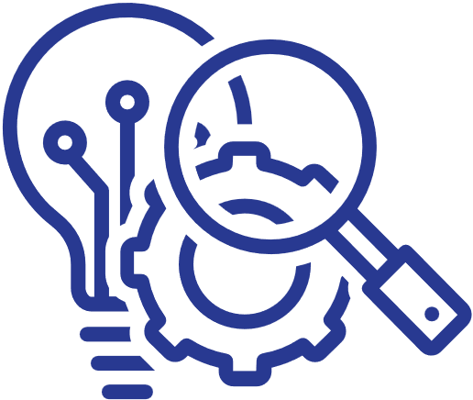
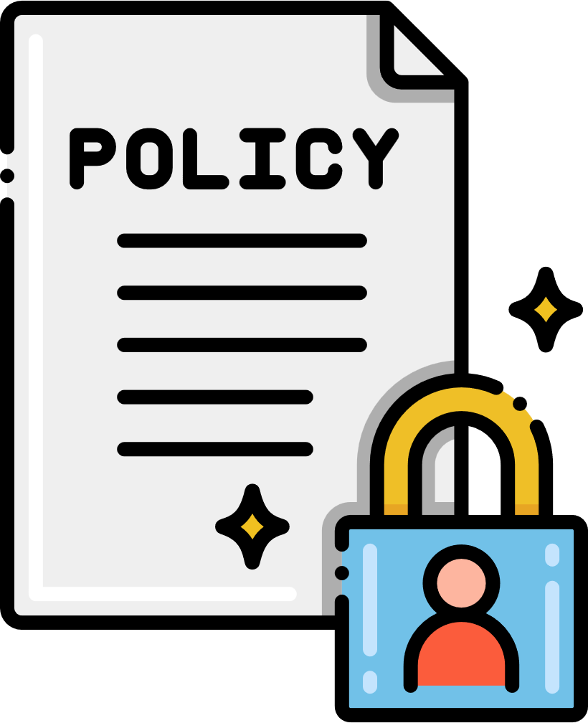
Real-Life Examples of RWD and RWE in Action
Medication Safety: RWD can reveal side effects of medications in real life, and RWE helps adjust treatment guidelines.
Chronic Disease Management: RWD tracks how patients with chronic illnesses (e.g., MS, diabetes) are doing, while RWE helps doctors figure out the best treatments.
Drug Development: RWD helps researchers understand the needs of patients, and RWE tests how well new drugs work in everyday settings.
Health Policies: Governments use RWD to spot healthcare problems and RWE to create better policies.

Slide 11

What Are Data Registries?
  Definition: A data registry is a collection of information about patients with specific conditions or treatments, like cancer registries.
  Purpose: Registries collect long-term data to track disease patterns, treatment outcomes, and patient demographics (age, gender, lifestyle)
  Importance: They help researchers study diseases over time, monitor treatment success, and improve patient care.

Slide 12

Why are Data Registries important for Patients?
Data registries are incredibly valuable for patients.
They help doctors understand how disease affects a person over time, track which treatments are working, and provide researchers with the data they need to create better treatments for the future.
Understanding Disease: Registries show how diseases behave over time and in different groups of people.
Tracking Treatment Success: They help doctors see which treatments work well and which may need improvement.
Supporting Research: Registries provide data that helps develop new treatments and improves care for future patients.

Slide 13
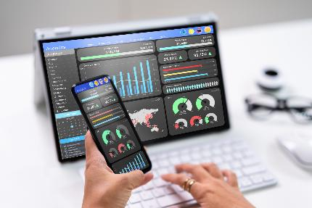
Summary
  Real-World Data (RWD) is the raw data from your healthcare experiences.
  Real-World Evidence (RWE) is the result after analyzing RWD to improve healthcare.
  Data registries play a key role in helping doctors and researchers understand diseases and treatments better, leading to improved patient care.
12

Slide 14
Further Readings
  Slide 3: Sources of Real-World Data: Patient Registries Overview - EMA
Purpose: To provide an overview of patient registries and their role in healthcare, as discussed in the data sources section.
  Slide 4: The Power of Patient-Reported Outcomes (PROs): Patient-Reported Outcomes in Clinical Practice
Purpose: Gives insights into how PROs are used in clinical settings to understand patient experiences and outcomes.
  Slide 6: Classification of Health Data: World Health Organization Classification Systems
Purpose: Details the WHO's classification systems for health data, including the family of data sets related to health.
  GDPR and Health Data: GDPR Recital 35: Personal Data Concerning Health
Purpose: Provides legal context for how health data is classified and protected under GDPR regulations.

Slide 15
Further Readings
  Slide 10: The Importance of Data Registries: German Cancer Registry
Purpose: Offers information about cancer registries in Germany, which are a specific type of data registry used to collect valuable information about cancer patients.
  Slide 10: Importance of Patient Registries for Medicine Evaluation: Why Patient Registries Are an Underused Resource for Medicines Evaluation
Purpose: Explains how patient registries can support the evaluation of medicines and their benefits, providing a research-based perspective.

Slide 16
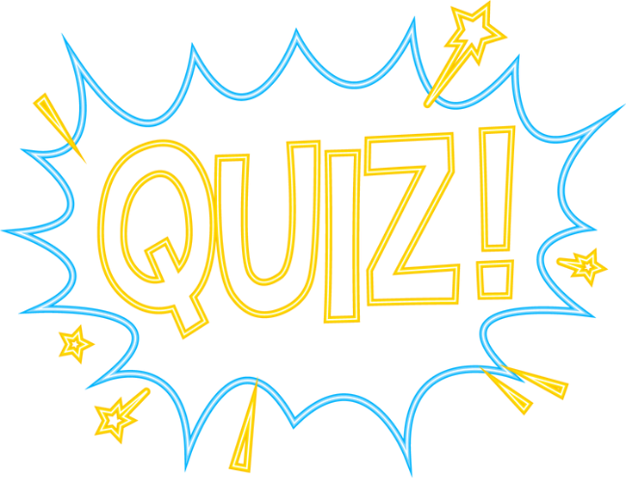
Quiz

Slide 17
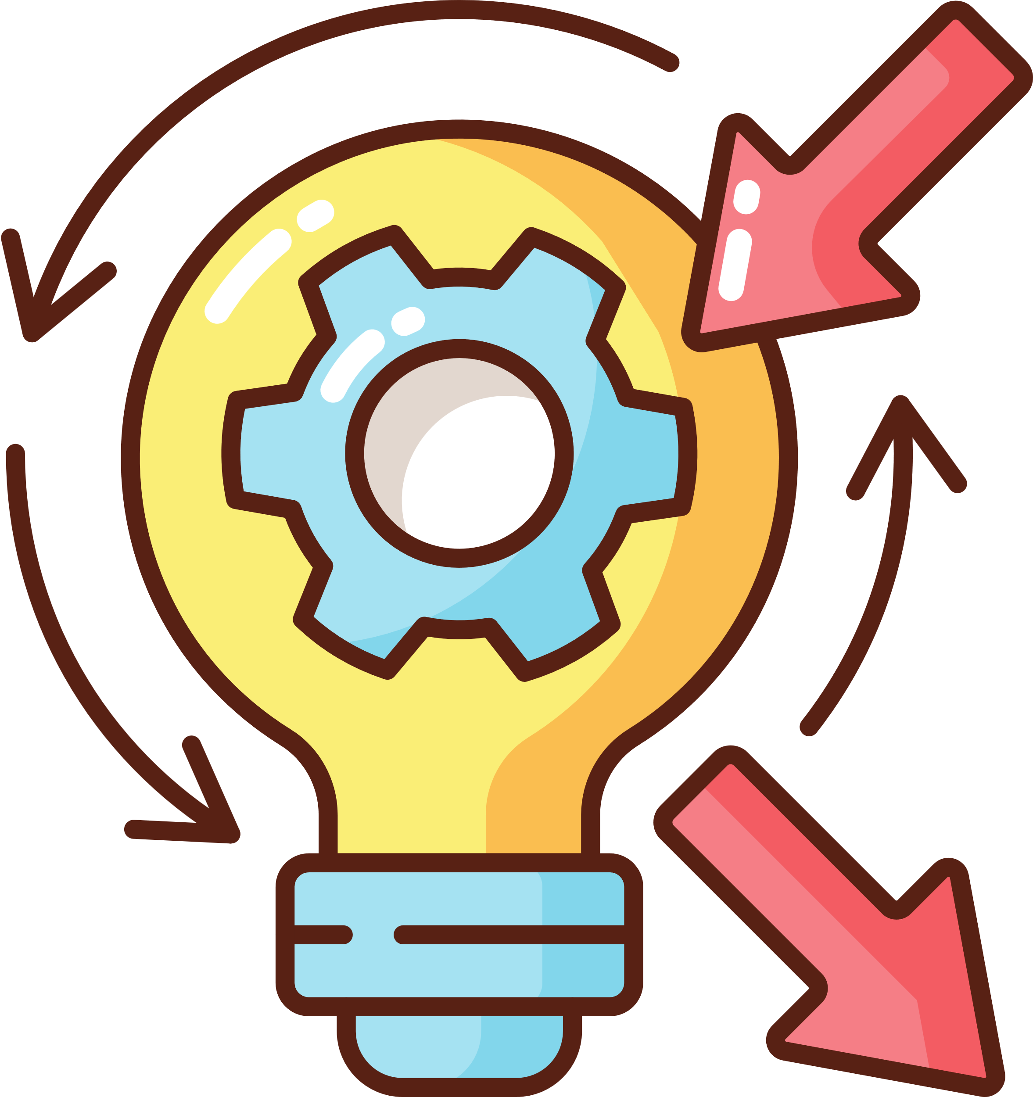

Reflective Question
How can the insights gained from data registries and Real-World Data (RWD) enhance patient outcomes and care?
  There is no wrong or right answer
16

Slide 18
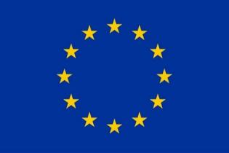
Funding
This project has received funding from the European Union’s Horizon Europe Research and Innovation Actions under grant no. 101095479 (More-EUROPA). Views and opinions expressed are however those of the author(s) only and do not necessarily reflect those of the European Union nor the granting authority. Neither the European Union nor the granting authority can be held responsible for them.

