Slide 1

Real-World Data: How Sharing and Analysis Can Benefit You
Session 6
Examples of Real-World Data (RWD) Studies and the impact of it
How Real-World Data Improves Patient Care

Slide 2

Case Study 1: Customizing Cancer Treatment (HER2-Positive Breast Cancer)
  Understanding HER2: HER2 is a protein that, when present in high amounts, can make some breast cancers grow faster. About 1 in 5 patients with breast cancers are HER2-positive.
  Using RWD: Data from real-world settings (such as patient records from multiple hospitals) has helped researchers develop more personalised treatments.
  Outcome: By analyzing this data, doctors can determine which patients will respond best to certain therapies, leading to more effective treatments and fewer side effects.
  Key Point: RWD has helped healthcare providers tailor treatments to the specific needs of patients with HER2-positive breast cancer, improving survival rates and quality of life.
  Further reading about Breast Cancer and Treatments and the HER2: Breast Cancer Treatment (PDQ®)–Patient Version and Real-world clinical outcomes of patients with stage I HER2-positive breast cancer treated with adjuvant paclitaxel and trastuzumab

Slide 3
Reflective Question for Cancer Treatment
How do you think using real-world data to customise cancer treatments could change the way we treat other diseases in the future?

Slide 4
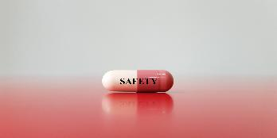
Case Study 2: Ensuring Drug Safety (Pharmacovigilance)
  What is Pharmacovigilance? It’s the process of monitoring the safety of medicines after they have been approved and are in use by patients.
  Using RWD: Real-world data helps track side effects reported by patients and healthcare providers. It can identify rare side effects not seen during clinical trials.
  Where to Report: In Europe, doctors and patients can report side effects to agencies like the European Medicines Agency (EMA), and the reports are used to continuously monitor the safety of drugs. Patients can also report their side effects directly to the pharmaceutical company who produces the drug. The Pharmaceutical companies are in duty to report this and make sure, that medications are safe. E.g. Germany gives via the Paul-Ehrlich-Institute all the opportunity to report, Data are safely stored and the patient data are anonymously. No name, just the gender and the age, the side effect and the dose.
  Outcome: Thanks to RWD, side effects can be identified earlier, leading to changes in how medications are prescribed or monitored. This improves the overall safety of treatments.
Further Reading: EMA - Pharmacovigilance - Overview

Slide 5
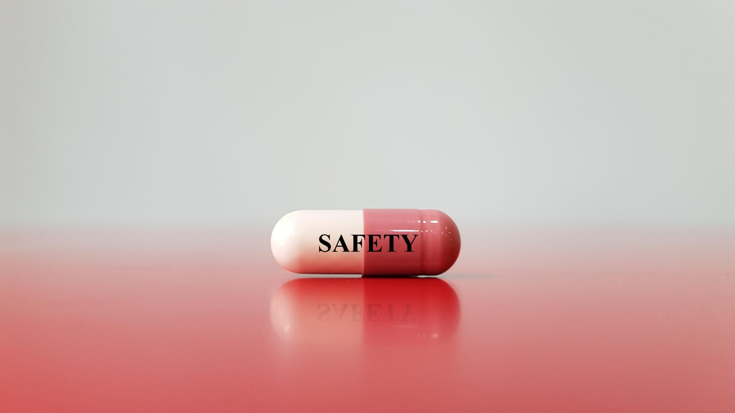
Reflective Question for Drug Safety
How do you think reporting your own experience with a medication could help make it safer for others?

Slide 6
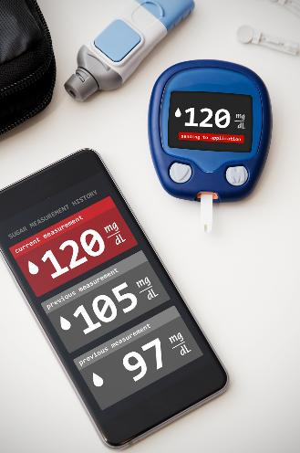
Case Study 3: Health Tech and Wearables for Diabetes Management
  About Diabetes: Diabetes is a chronic condition where the body struggles to manage blood sugar levels. It can lead to serious health issues if not managed well.
  Using RWD: Wearable devices, like fitness trackers and continuous glucose monitors, provide real-time data on a patient’s health, such as blood sugar levels, activity, and heart rate.
  Outcome: This data helps patients better manage their condition day-to-day and allows doctors to adjust treatments based on real-time information. It also empowers patients by giving them more control over their own health.
  Key Point: Wearable devices are making diabetes management more efficient and personalised, improving patient outcomes and quality of life.

Slide 7
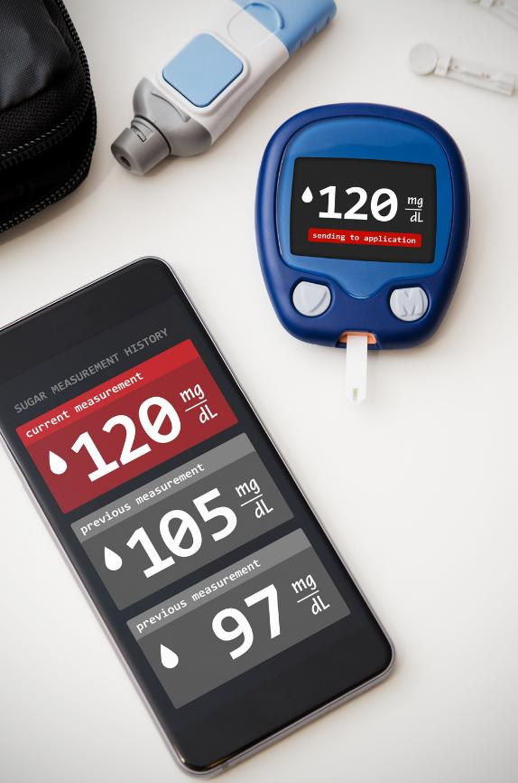
Reflective Question
If you use a fitness tracker or health app—how would you feel about sharing that data for research, if privacy was guaranteed?
7

Slide 8
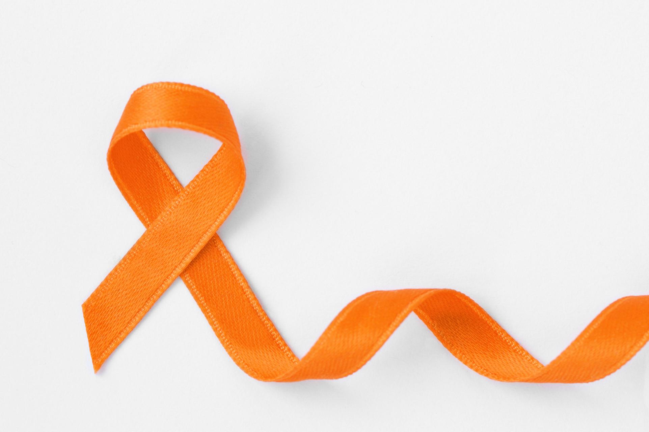
Case Study 4: Using RWD to Improve Multiple Sclerosis (MS) Treatment
  About MS: Multiple sclerosis (MS) is a disease where the immune system attacks the nerves, leading to issues with movement, balance, and vision.
  Using RWD: Data from health insurance records and hospitals has been used to track MS patients’ adherence to prescribed medications and the progression of the disease.
  Outcome: This data helps researchers understand which treatments are working best and where patients might be struggling to stick to their treatment plans. It also shows how many prescriptions are being given in different regions, which can highlight areas where more education or support may be needed.
  Key Point: RWD helps healthcare providers identify where MS patients may need more help staying on track with their treatments, improving their long-term outcomes.

Slide 9
Reflective Question for MS Treatment
How could tracking medication adherence through data improve the care of people with long-term conditions like MS?

Slide 10
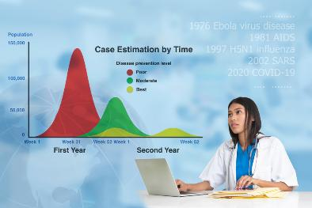
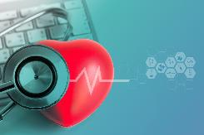
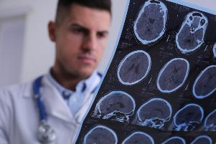
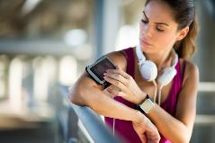


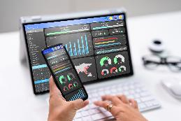
Summary of key takeaways
  RWD helps customise treatments, improve drug safety, and track health in real time.
  Wearable devices and insurance data are transforming healthcare, especially for chronic conditions.
  Patients play an important role by contributing their own health data and reporting side effects.
10

Slide 11

Further Readings
Slide 2:
  Breast Cancer Treatment (PDQ®)–Patient Version
  Real-world clinical outcomes of patients with stage I HER2-positive breast cancer treated with adjuvant paclitaxel and trastuzumab
Slide 4:
  EMA - Pharmacovigilance - Overview
  WHO - About Pharmacovigilance
  WHO Uppsala Monitoring Center - UMC - Worlds largest Data Base of Side Effect Reporting
Slide 6:
  Technology in the Management of Diabetes Mellitus
Slide 8:
  National Multiple Sclerosis Society – Managing MS with Data and Technology
  Multiple Sclerosis Data Alliance – A global multi-stakeholder collaboration to scale-up real world data research
11

Slide 12

Reflective Activity
  Choose one of the case studies (Cancer, Drug Safety, Diabetes, or MS).
  Answer the reflective question or create a video sharing your thoughts with the group.
13

Slide 13
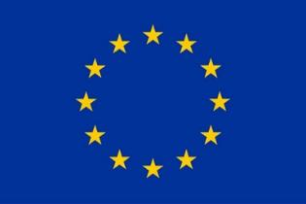
Funding
This project has received funding from the European Union’s Horizon Europe Research and Innovation Actions under grant no. 101095479 (More-EUROPA). Views and opinions expressed are however those of the author(s) only and do not necessarily reflect those of the European Union nor the granting authority. Neither the European Union nor the granting authority can be held responsible for them.

