Slide 1



Real-World Data: How Sharing and Analysis Can Benefit You
Session 5
Ethical Considerations in Real-World Data (RWD)
  Data privacy and security
  Informed consent
  Bias in data
  Emerging technologies (e.g., AI) and new privacy challenges

Slide 2

Data Privacy and Security
What is Data Privacy?
Protecting individuals' personal information from unauthorised access.
What is Data Security?
Using measures like encryption, firewalls, and secure storage to protect sensitive data.
Why does it matter in Healthcare:
  Medical data is highly sensitive.
  Data breaches can harm patients and damage trust.
  Ethical handling of data ensures confidentiality.

Slide 3

Informed Consent in RWD
What is informed consent?
  Ensuring patients fully understand how their data will be used before it is collected.
  Informed consent is a form what has to respect regulations and policies therefore in can be a lot to read for patients very often.
Why it’s important:
  Builds trust between healthcare providers and patients - it is like a contract and gives an overview about rights and obligations.
  It is required for ethical and legal reasons.
Challenges:
  Patients may not fully understand how their data will be used, especially in large RWD studies - therefore Patient Organisations discuss with the policy makers for easy to read versions very often.
  Healthcare providers must ensure transparency in every aspect.

Slide 4

Bias in RWD Collection and Use
What is a Bias?
  Bias refers to systematic errors in data collection or analysis that can lead to unfair or inaccurate conclusions.
  Also a person can be biased once the person starts to talk about an important theme where the person is involved in - you can't stay neutral very often.
How Bias affects healthcare:
  If certain groups (e.g., minorities, older adults) are underrepresented in the data, it can lead to unequal healthcare decisions.
  Healthcare outcomes may not be equitable.

Slide 5


Bias in RWD Collection and Use - Examples
  Doctors might be more likely to look for diabetes in obese patients than in skinny patients. As a result, one may observe an inflated estimate of diabetes prevalence among obese patients.
  A healthcare study using RWD may overrepresent young, healthy individuals, leading to less accurate care for older patients.
  Algorithms trained on biased data can make incorrect predictions for minority populations.
Why addressing Bias matters:
  Addressing bias is crucial to ensure fair and equitable healthcare outcomes for all populations.
  It can be also that older patients or patients from other ethic groups fall into a biased situation.

Slide 6

Ethical AI and RWD
AI and RWD:
  AI systems are used to analyse RWD for patterns, predictions, and improving healthcare decisions.
Challenges:
  AI must use unbiased, representative data to avoid unfair outcomes.
  AI systems must be explainable and transparent to build trust.
Example:
  AI systems predicting patient outcomes using biased data can lead to inaccurate or unfair decisions.

Slide 7

Privacy and Security: European Regulations (GDPR)
General Data Protection Regulation (GDPR):
Introduced in May 2018 by the European Union to protect personal data and privacy.
Developed by: European Parliament, Council of the European Union, European Commission.
Why GDPR matters:
  GDPR ensures that all personal data, including health data, is protected.

Slide 8

Emerging Technologies: AI and Healthcare Data
How AI and RWD connect:
  AI is used to analyse RWD to improve patient care and predict outcomes. However, new ethical and privacy challenges arise.
Challenges with AI:
  AI must use unbiased, representative data.
  Decisions made by AI must be transparent and explainable to build trust.
Link to Privacy and Security:
  The new AI Act (entered into force as from July 12th 2024 in Europe aims to ensure AI systems follow data protection rules (like GDPR) and are transparent in their use of healthcare data and analyse Data in an ethical, transparent and non-discriminating way. Every EU Country has to follow the rule and prepare policies for the own national systems. https://artificialintelligenceact.eu

Slide 9
HIPAA: Data Protection in the US
HIPAA: Health Insurance Portability and Accountability Act
Enacted on August 21st in 1996 to protect health information in the US.
Key Elements:
  Privacy Rule: Ensures patient confidentiality.
  Security Rule: Requires secure handling of electronic health information (e.g., encryption). https://www.cdc.gov/phlp/php/resources/health-insurance-portability-and-accountability-act-of-1996-hipaa.html
Comparison to GDPR:
  HIPAA applies only to the healthcare sector in the US, whereas GDPR protects all personal data, including health data, across all industries in Europe.

Slide 10


Summary: Ethical Considerations in RWD
  Data Privacy and Security: Ensuring patient data is anonymized, encrypted, and protected under regulations like GDPR and HIPAA.
  Informed Consent: Patients must understand how their data will be used and provide explicit consent.
  Bias in Data: It's critical to avoid biases in data collection and analysis to ensure healthcare is fair and equitable for all groups.
  AI and Emerging Technologies: While AI provides new ways to analyse RWD, it raises new ethical questions about transparency, bias, and accountability.

Slide 11
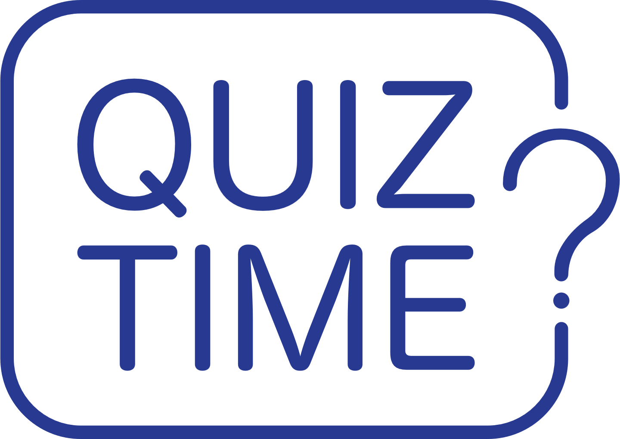

Quiz

Slide 12

Further Readings
  GDPR Guidelines: Learn more about Europe's privacy regulations: GDPR Compliance
  HIPAA Overview: Learn about the US healthcare data protection framework: HIPAA Information
  Informed Consent in Research:Read about how informed consent works in healthcare research: https://researchsupport.admin.ox.ac.uk/governance/ethics/resources/consent
  Addressing Bias in Data: Dive into how bias affects healthcare data and ways to mitigate it - A systematic Review in the Elsevier Journal
  AI and Healthcare Data Privacy: Explore how AI affects data privacy and security: https://bmcmedethics.biomedcentral.com/articles/10.1186/s12910-021-00687-3

Slide 13


Reflective Question
What steps can you take to ensure ethical practices in handling patient data in your organization?
  There is no wrong or right answer

Slide 14

Funding
This project has received funding from the European Union’s Horizon Europe Research and Innovation Actions under grant no. 101095479 (More-EUROPA). Views and opinions expressed are however those of the author(s) only and do not necessarily reflect those of the European Union nor the granting authority. Neither the European Union nor the granting authority can be held responsible for them.

