Slide 1
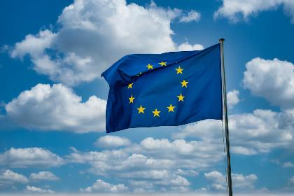



Real-World Data: How Sharing and Analysis Can Benefit You
Session 1
Creating a Data Union with the European Health Data Space - Introduction to the European Health Data Space (EHDS) and Real-World Data (RWD)

Slide 2

What is the European Health Data Space (EHDS)?
  Introduced by the EU in 2022 as part of the European Commission’s Digital Health Strategy.
  Aims to establish a secure, patient-centric digital space for health data sharing across EU member states.
  Designed to give patients control over their health data while promoting better healthcare, faster research, and health innovations.
  Offers the potential for healthcare providers and researchers to access and use data across borders for more personalized treatments and medical advancements.
  EHDS was finally “approved” in 2024 - Member States are working on frameworks to be able to connect

Slide 3

How Countries need to prepare
  Upgrading digital infrastructure: EU countries need to ensure they have secure, modern systems that allow data to be shared and accessed across borders.
  Interoperability: Countries must adopt common technical standards so health data systems in one country can "talk" to those in another. This is key to ensuring that a patient’s medical record is accessible across different EU states.
  Healthcare workforce training: Providers must be trained to use new digital tools and systems effectively.
  GDPR compliance: Countries must ensure they adhere to strict privacy rules under the General Data Protection Regulation (GDPR) to protect personal health data.
  What a lot of patient organisations / patient experts also citizens are discussing: involvement of patients / citizens in the development as early as possible. In some countries this happens, in some not so good.

Slide 4

How does EHDS relate to Real-World Data (RWD)?
  RWD is health data collected in real-life settings, such as hospitals, electronic health records (EHRs), clinical notes, wearables, and even mobile health apps.
  EHDS will create a system where RWD can be shared securely across EU countries.
Benefits include:
  Personalised treatments: Doctors can access broader data to tailor treatments to individual patients.
  Better research: Access to RWD from diverse populations across Europe enables more inclusive and robust medical studies.
  Faster healthcare improvements: Innovations in treatment, prevention, and care will be accelerated through better use of RWD.

Slide 5
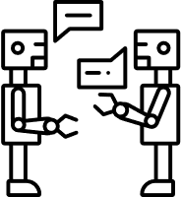
Interoperability: The Key to Success
  Interoperability means that different health systems, across EU countries, can easily exchange data in a secure and understandable way.
  Ensures health data can be accessed and used by healthcare providers regardless of where a patient is in Europe.
  Requires countries to adopt common technical standards and protocols for data exchange.
Interoperability is critical for:
  Cross-border healthcare: Patients can receive care in another EU country, and their medical history will be available to doctors there.
  Emergency situations: Doctors can quickly access patient records in emergencies, even if the patient is in another EU country.

Slide 6
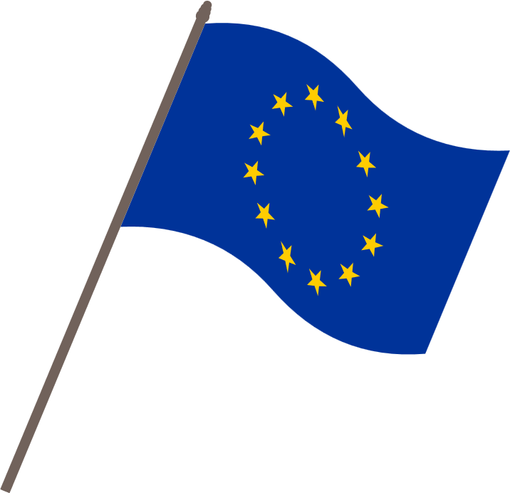
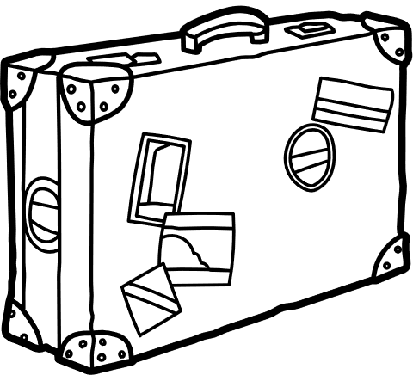
Opportunities for Health Data Exchange
  Cross-border access to health records for travelers and residents.
  Faster disease surveillance and detection of outbreaks.
  Prevention - Secondary use of health data
  Pandemic Planing - Data we exchange can help to move forward with care planing in a pandemic. Covid!
  More inclusive research using data from diverse populations > equity, dignity and inclusion.
Health Data
6

Slide 7

The Ethical Side: GDPR and Privacy Part 1
  The General Data Protection Regulation (GDPR), introduced in 2018, sets strict rules on how personal data is collected, stored, and used across the EU.
  The EHDS will comply with GDPR standards to protect patient privacy.
  Key GDPR principles for health data:
    Informed consent: Patients must be informed about how their data will be used and give their explicit consent.
    Right to access and control: Patients have the right to see their data and control who has access to it.
    Data security: Health data must be stored securely to prevent unauthorized access.

Slide 8

The Ethical Side: GDPR and Privacy Part 2
Data Security and Patient Trust
  Security protocols: Strict technical safeguards will be in place to ensure health data is encrypted and protected.
  Data minimisation: Only the minimum amount of data necessary will be shared, ensuring privacy.
  Transparency: Patients will have access to detailed information about how and where their data is used.
  EHDS vision: Trust is at the heart of the EHDS—patients need to feel confident that their health data is secure and used ethically.

Slide 9
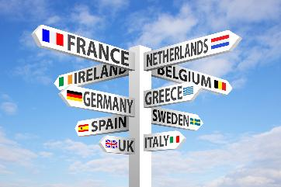
Benefits
  Patients will have better control over their personal health data.
  Access to more personalized treatments, as doctors can use data from all over Europe to tailor care to individual needs.
  Healthcare professionals can provide better care by accessing up-to-date, cross-border health records.
  The EHDS will accelerate medical research, leading to faster discoveries and innovations, including better treatments and cures.
8

Slide 10
Summary
  The European Health Data Space (EHDS) is a key EU initiative introduced in 2022 to create a secure, interoperable, and patient-centered system for sharing health data across Europe.
  By ensuring compliance with the General Data Protection Regulation (GDPR), the EHDS will protect patient privacy while giving individuals control over their personal health data.
  Real-World Data (RWD) plays an essential role in this system by allowing healthcare providers and researchers to access data from real-life settings (hospitals, wearables, health apps) to drive personalized healthcare and medical research.
  Interoperability is critical: for the EHDS to succeed, all countries must adopt common standards to ensure that health systems can securely and efficiently exchange data across borders.
  Benefits for patients include better healthcare access, personalized treatments, and the acceleration of medical research, which can lead to faster healthcare innovations and cures.

Slide 11
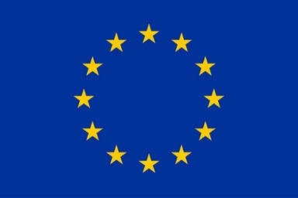
Funding
This project has received funding from the European Union’s Horizon Europe Research and Innovation Actions under grant no. 101095479 (More-EUROPA). Views and opinions expressed are however those of the author(s) only and do not necessarily reflect those of the European Union nor the granting authority. Neither the European Union nor the granting authority can be held responsible for them.

